Slide 1
Applying References and Hyperlinks in Word 2010
Created by: Jennifer Tyndall, Spring Creek High School

Slide 2
What is a hyperlink?
A hyperlink is colored and underlined text or a colored and underlined graphic that you click to open any one of the following items:
A file
A location in a file
A Web page on the Web

Slide 3
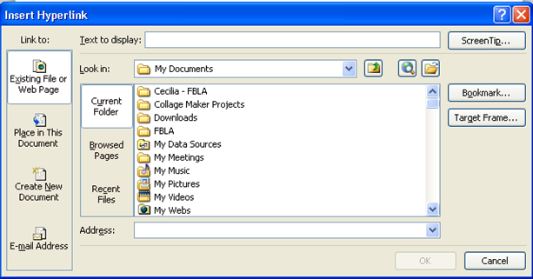
Insert Hyperlinks
Insert Ribbon, Links group, click “Hyperlink”
Options to Link to: Existing File or Web Page, Place in the Document, Create New Document, or Email address
To insert a hyperlink to a web page, type in the web address and click OK

Slide 4
Add Hyperlinks to Text
Select the text you want to hyperlink
Go to Insert, Hyperlink
Type in the web address and click OK
To view the web page you hyperlinked, hold down the CTRL key and click on the link (it will open up the link in Internet Explorer)

Slide 5
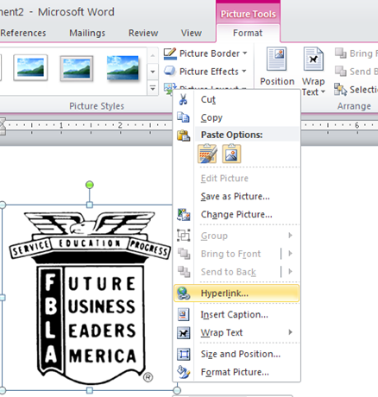
Add Hyperlinks to Graphics
Right-click on picture, and select Hyperlink
Select “Link to” option (web page is most common)
Type in the web address and click OK
When you press CTRL + click on the picture, it will take you to the specified web page

Slide 6
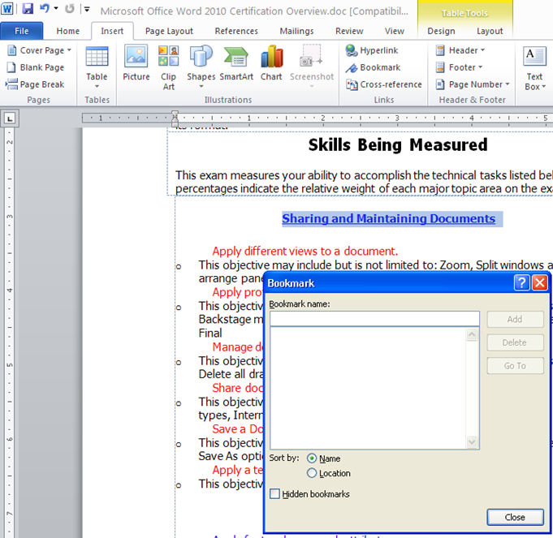
Bookmarks
Create bookmarks to assign a name to a specific point in a document
Also helpful in finding important information later
To create a bookmark:
Highlight what you want to book mark
Insert Ribbon, within the Links group, and click on “Bookmark”
Assign a name to the bookmark (no spaces!)
Click “Add”

Slide 7
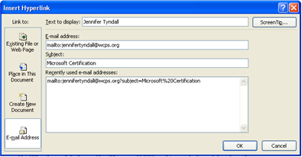
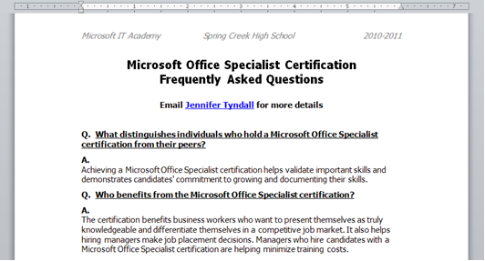
Email Addresses as Hyperlinks
Used to simplify the way people respond to electronic documents
1. Highlight text you want hyperlinked
2. Insert, Hyperlink, select E-mail Address
3. Type in email address and subject of email, click OK
When you press CTRL + the hyperlink, MS Outlook will open your email account and start an email to the person specified by the hyperlink

Slide 8
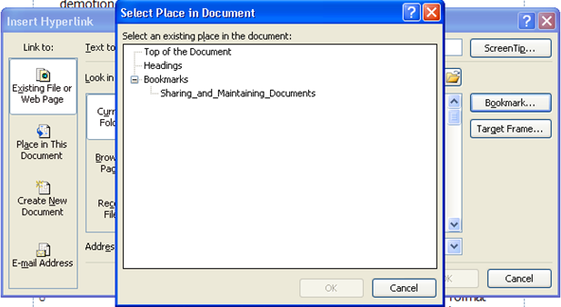
Hyperlinking Bookmarks
You can make hyperlinks that jump to a specific point in a document
Often times used to return to the beginning of a page or document
1. Select text
2. Insert, Hyperlink
3. Click on “Bookmark”
4. Select Bookmark you want to hyperlink
5. Click OK twice

Slide 9
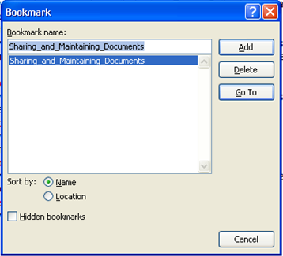
Viewing Bookmarks
To go to a bookmark you have created, click on Insert > Bookmark
Select the bookmark, and click “Go To”
Your cursor will move to the bookmarked section of your document

