Slide 1
Formatting Content in Word 2010
Created by Jennifer Tyndall, Spring Creek High School

Slide 2
Font Attributes
Font formatting – appearance, size, and attributes of text
Found on Home Ribbon within the Font group
Includes: bold, italics, underline, font type and size, grow font, shrink font, change case, clear formatting, strikethrough, subscript, superscript, text highlighter (also a navigation feature), and font color

Slide 3
Format Painter
Found on the Home Ribbon within the Clipboard group
Used to apply text formatting and some basic graphics formatting, such as borders and fills
Select the text or graphic to be copied
Click on the Format Painter icon
Select the text to be formatted
Click ESC to cancel Format Painter

Slide 4
Apply Styles
global formats for headings and other text within a document
Highlight text
Scroll mouse over styles to preview them in your document
Select style that fits your document’s purpose

Slide 5
Paragraph Attributes
Paragraph formatting–arrangement of text within paragraphs on a page
Found on Home Ribbon within the Paragraph group

Slide 6
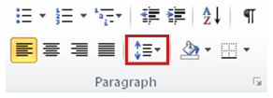
Line and Paragraph Spacing
Found on the Home Ribbon in the Styles group
Select paragraphs
Click Line Spacing icon
Select number of line spaces (1.0 to single space, 2.0 to double space, etc)

Slide 7
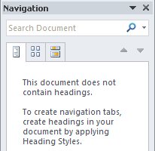
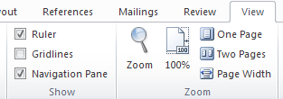
Navigating through Documents
Navigation Pane – Found on View Ribbon in Show group

Slide 8
“Browse By” Buttons
Browse by the headings in your document (will not work if your document does not contain headings)
Browse by the pages in your document
Displays a thumbnail of your pages
Browse by the results from your current search
Type keywords in the “Search Document” box

Slide 9
Find and Replace
Found on the Home ribbon within the editing group
a feature that allows global edits to a document
For formatting options, click “More” then select “Format”, “Font”

Slide 10
Indents
Found on Page Layout Ribbon within the Paragraph group
ALSO found as icon on Home Ribbon

Slide 11
Setting Tabs
By using the Ruler:
Click the tab selector at the left end of the ruler until it displays the type of tab that you want
Click the ruler where you want to set the tab stop

Slide 12
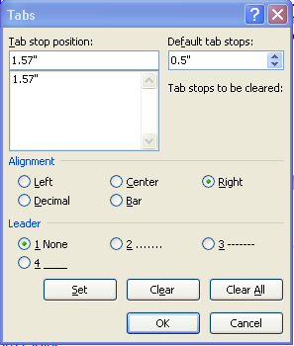
Setting Tabs (cont’d…)
By using the Tabs Dialog Box:
Used when you want to add
leaders/characters
Double-click the ruler
Specify tab stop position,
alignment, and leader

Slide 13
Clear Tabs
Select the tab stop and click on “Clear” for specific tabs, OR
Click on “Clear All” to clear all tabs

