Slide 1
Formatting Content in Word
(Tables)
Created by Jennifer Tyndall (Spring Creek High School)

Slide 2
3 Ways to insert tables
Choose from a gallery of preformatted table templates
Use the Table menu to specify the number of rows and columns that you want
Use the Insert Table dialog box

Slide 3
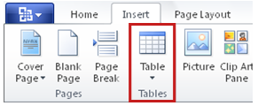
Table Templates
1. Click where you want to insert a table.
2. On the Insert tab, in the Tables group, click Table, point to Quick Tables, and then click the template that you want.
3. Replace the data in the template with the data that you want.

Slide 4
Table Menu
1.Click where you want to insert a table
2.On the Insert tab, in the Tables group, click Table, and then, under Insert Table, drag to select the number of rows and columns that you want

Slide 5
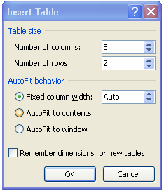
Table Dialog Box
1.On the Insert tab, in the Tables group, click Table, and then click Insert Table
2.Under Table size, enter the number of columns and rows.
3.Under AutoFit behavior, choose options to adjust the table size.

Slide 6
Draw A Table
1. On the Insert tab, in the Tables group, click Table, and then click Draw Table
2. The pointer changes to a pencil
3.To define the outer table boundaries, draw a rectangle. Then draw the column lines and row lines inside the rectangle
4.To erase a line or block of lines, under Table Tools, on the Design tab, in the Draw Borders group, click Eraser
5.Click the line that you want to erase

Slide 7
Convert Text to Tables
1. Insert separator characters — such as commas or tabs — to indicate where you want to divide the text into columns
2. Select the text that you want to convert
3. On the Insert tab, in the Tables group, click Table, and then click Convert Text to Table
4. In the Convert Text to Table dialog box, under Separate text at, click the option for the separator character that you used in the text.

Slide 8
Splitting Cells
Allows you to create multiple columns or rows out of one cell
Right-click in cell
Select “Split Cells”
Type in # of columns and rows and click “OK”

Slide 9
Merging Cells
Allows you to combine multiple columns or rows out of two or more cell
Highlight cells or columns to merge
Right-click and select “Merge Cells”

Slide 10
Manipulating Data in Tables
Sort Content
Found on Home Ribbon within
the Paragraph group
Add Columns/Rows
Found on Table Tools “Layout” Contextual tab
Highlight row or column, then select icons Insert Below, Left, Right, or Above
View Gridlines by clicking on the icon

Slide 11
Manipulating Data (cont’d)
Converting Tables to Text
Found on the Table Tools “Layout” Contextual tab
View Gridlines
Same tab, used to show gridlines in tables

Slide 12
Manipulating Data (cont’d)
Header Row
Found on the Table Tools “Design” Contextual tab
Primarily used to display column headings (in table styles)
Delete Rows/Columns
Found on the Table Tools “Layout” Contextual tab

