Slide 1
Illustrations and Graphics in Word 2010
Created by: Jennifer Tyndall (Spring Creek High School)

Slide 2
How to Insert pictures
Found on the Insert Ribbon within the Illustrations group
Picture Icon – inserts pictures from saved files
ClipArt – inserts pictures from the ClipArt Dialog Box
Shapes – inserts ready-made shapes such as rectangles, arrows, etc.
SmartArt – inserts a picture to visually communicate your data (venn diagrams, etc)

Slide 3
Artistic effects and corrections
Found on Picture Tools “Format” Contextual Tab
Artistic Effects make your picture look like a sketch or a painting
Samples include: Marker, paintbrush, glass, crisscross etching, etc
Corrections improve the brightness, contrast, or sharpness of the picture

Slide 4
Modify the shape of pics
Found within the Picture Style group
Before After

Slide 5
Inserting Captions
Insert a picture, then right-click and select Insert Caption

Slide 6
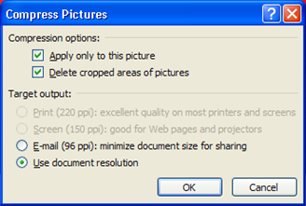
Compress pictures
Found on the Picture Tools Format Contextual tab, within the Adjust group
Used to reduce the size of pictures

Slide 7
Wordart
Found on the Insert Ribbon within the text group
Inserts decorative text in your document
Can be customized on the Drawing Tools Format Contextual tab within the WordArt Styles group

Slide 8
SmartArt
Found on the Insert Ribbon within the Illustrations group
Graphical representation of your data
Select the SmartArt graphic of your choosing, and replace the data with what you want to appear
To modify your SmartArt, select the SmartArt Tools contextual tab, and look through the Design & Format ribbons
Includes changing the shape, layout, colors, etc.

Slide 9
clipart
Found on the Insert Ribbon within the Illustrations group
Includes drawings, movie clips, sounds, or photography

Slide 10
textboxes
Insert Ribbon, Text group
If you design your own text box (shadow effects, colors, etc), you can save it for later use by:
Selecting the textbox
Click on the Text Box icon
Select “Save Selection to Text Box Gallery”
To change the direction of your text within a textbox, select the Drawing Tools Format Contextual Tab, and choose a direction under “Text Direction”

Slide 11
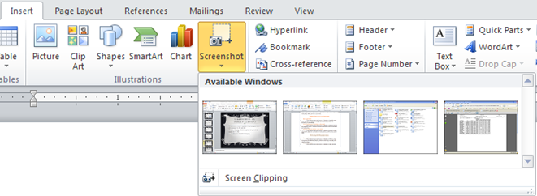
Screenshot vs. screen clipping
Screenshot – Inserts a picture of any program that is not minimized to the task bar
Screen Clipping – Inserts a picture of part of the screen into the file
Eliminates the need for cropping

