Slide 1
Mail Merge in Word 2010
Created by: Jennifer Tyndall, Spring Creek High School

Slide 2
What is mail merge?
Businesses and organizations often want to send the same letter to several people (mass mailings)
Ex: credit card applications
Mail merging combines a word processing document with a data source
Data Source: List of names and addresses to produce personalized documents
Hundreds of individual letters, certificates, labels, and envelopes can be created with just two documents (improved

Slide 3
Mail merge includes:
Main document: Contains special mail merge fields that act as placeholders for the recipient’s name and address
Data Source: Lists the specific recipient information

Slide 4
Mail merge wizard
Wizards are similar to templates, but there are step-by-step instructions (in numerical order)
Mailings Ribbon, click on Start Mail Merge, “Step by Step Mail Merge Wizard”

Slide 5
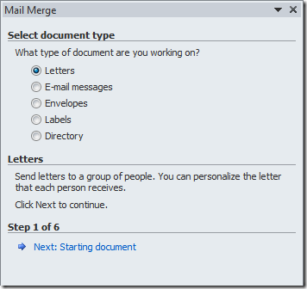
Step 1
Mail Merge Dialog Box will appear on the right side of your document window
Select the type of document you will be working with (usually letters)
Then click “Next: Starting Document”

Slide 6
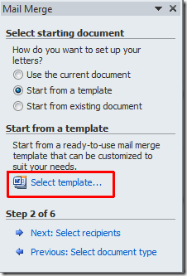
Step 2
In this step, you will be provided with different options to create Letters
“Use the current document” – you want to type your own letter
“Start from a template” – select templates from the computer
Then click “Next: Select Recipients”

Slide 7
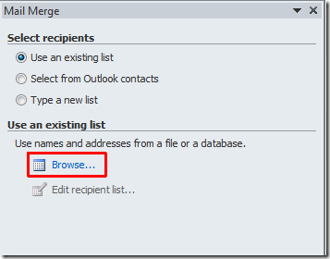
Step 3
“Use an existing list” – database of names and additional information saved on the computer
“Select from Outlook contacts” – must have MS Outlook configured (email)
“Type a new list” – key your names and additional information directly into the wizard
**NOTE: To add custom fields, select the “Customize Columns” then “Add”

Slide 8
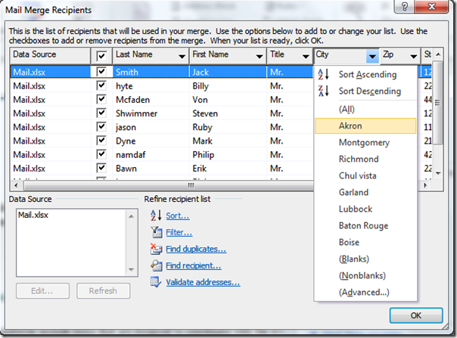
After selecting or keying your list, the “Mail Merge Recipients” Dialog box will appear
Add, change, or sort your list using the options
Click “OK”
Click “Next: Write your letter”

Slide 9
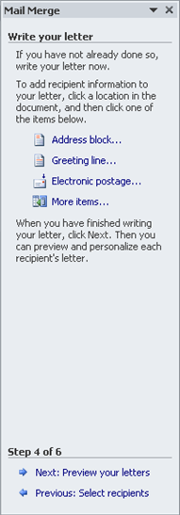
Step 4
At this step, key your letter if you haven’t already done so
Add placeholders to your document using the options in this step
Placeholders allow you to address the same letter to multiple recipients
After keying your letter, click “Next: Preview your letters”

Slide 10
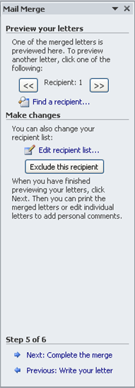
Step 5
This is the “editing” step of the Mail Merge Wizard
Once completing the merge, it is more difficult to make changes so it is important to proofread all letters in this step
Then click “Next: Complete the merge”

Slide 11
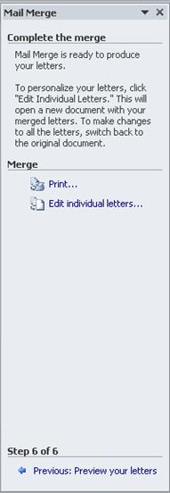
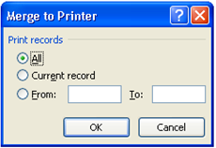
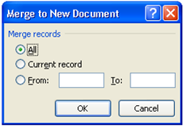
Step 6
In this final step, you can print or save your letters
“Print” – merges your documents to the printer
“Edit individual letters” – allows you to change/edit your letter and save them
If you have 20 recipients in your list, you will see 20 pages of letters in this step

