Slide 1
Page Layout & Reusable Content in Word 2010
Created by: Jennifer Tyndall, Spring Creek High School

Slide 2
Page Layout (Ribbon)
Margins: space around the edges of the document
Normal margins are set for 1’’ top, left, right, and bottom
To customize, click on the “Margins” icon
Page Orientation: Direction a document is printed
Portrait – Taller than wide
Landscape – Wider than tall

Slide 3
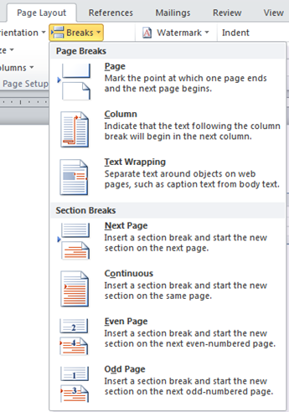
Page Breaks
Indicates that the maximum number of lines have been keyed on a page and a new page is beginning
Hard break - created by the user
CTRL + Enter or “Breaks” icon
Soft break - created by the word processing program
Automatic when you get to the end of a document

Slide 4
Section Breaks
The Next Page command inserts a section break and starts the new section on the next page
Useful for starting new chapters in a document
The Continuous command inserts a section break and starts the new section on the same page
Useful for creating a formatting change, such as a different number of columns, on a page
The Even Page or Odd Page command inserts a section break and starts the new section on the next even-numbered or odd-numbered page

Slide 5
Cover Pages and Blank Pages
Cover Page: inserts a fully formatted Title page in your document
Found on Insert Ribbon
You fill in the title, author, date, and other info
Blank Page: inserts a blank page at the cursor position (Insert Ribbon)
Hyphenation: Allows Word to break lines between the syllables of words (Page Layout Ribbon)
Used often in books/magazines to create uniform spacing

Slide 6
Hanging Indent
Found on the Home Ribbon within the Paragraph group
Click the Arrow to open the dialog box, found under “Special”
First line of text begins at the left margin and all other lines are indented
Used for works cited or bibliography pages
Example:
Hill, Sharon A. Wild Woman’s Guide to Etiquette: Saving the
World One Handshake at a Time, 2005.

Slide 7
Quick Parts
The Quick Part Gallery is a gallery where you can create, store, and find reusable pieces of content, including AutoText, document properties such as title and author, and fields.
The following 5 properties are located on the Insert Ribbon under the “Quick Parts” icon.

Slide 8
AutoText
Reusable content that you can store and access again and again
Found on Insert Ribbon, within the Text group
Click “Quick Parts”, then AutoText to access the AutoText gallery
Document Properties
Click Document Property to choose from a list of properties that you can insert in your document
Fill in the document property box with the text you want
Field
Use field codes to insert fields that can provide automatically updated information, such as the time, title, page numbers, and so on

Slide 9
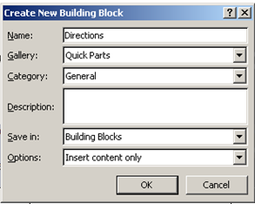
Building Blocks Organizer
Click Building Blocks Organizer to preview all of the building blocks available to you in Word
You can also edit properties, delete, and insert buildings blocks
Save Selection to Quick Part Gallery
Select a phrase, sentence, or other portion of your document
On the Insert tab, in the Text group, click Quick Parts, and then click Save
Selection to Quick Part Gallery
After saving the selection, you
can reuse it later

